Slide 1
Fundamentals of Computing 1
Lecture 07: Strings

Slide 2
Learning Objectives
To represent strings using the String object
To return the string length using the length() method
To return a character in the string using the charAt(i) method
To use the + operator to concatenate strings

Slide 3
Learning Objectives (cont’d.)
To return an uppercase string or a lowercase string and to trim a string
To compare strings using the equals method and the compareTo methods
To obtain substrings
To find a character or a substring in a string using the indexOf method

Slide 4
Agenda
Strings
Immutable String
String Comparison
String Concatenation
subString
Notes:
ask them, how might the computer store "hi" using binary digits? (some kind of mapping; ASCII)

Slide 5
Agenda
6. StringBuffer classs
7. Commonly used Methods of StringBuffer class
8. StringBuilder classs
9. Commonly used Methods of StringBuilder class
10. toString()
Notes:
ask them, how might the computer store "hi" using binary digits? (some kind of mapping; ASCII)

Slide 6
String
Generally string is a sequence of characters. But in java, string is an object. String class is used to create string object.
Notes:
String Handling provides a lot of concepts that can be performed on a string such as concatinating string, comparing string, substring etc.
In java, string is basically an immutable object.
We will discuss about immutable string later. Let's first understand what is string and how we can create the string object.

Slide 7
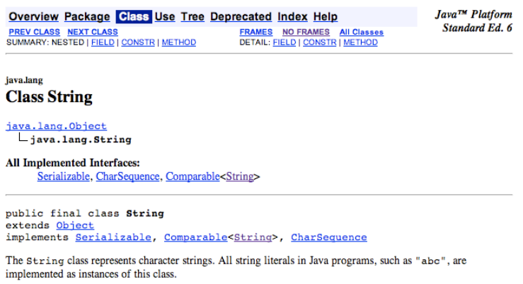
The String class

Slide 8
How to create String object?
There are two ways to create String object:
  By string literal
  By new keyword

Slide 9
By String literal
String literal is created by double quote.
Ex1: String s="Hello";
S
“Hello”
String constant pool
Heap
Notes:
Each time you create a string literal, the JVM checks the string constant pool first. If the string already exists in the pool, a reference to the pooled instance returns. If the string does not exist in the pool, a new String object instantiates, then is placed in the pool.

Slide 10
By String literal (cont’d.)
Ex2:
  String s1=“Welcome";
  String s2=" Welcome ";
Note: String objects are stored in a special memory area known as string constant pool inside the Heap memory.
S2
S1
“Welcome”
String constant pool
Heap
Notes:
In the above example only one object will be created. First time JVM will find no string object with the name "Welcome" in string constant pool, so it will create a new object. Second time it will find the string with the name "Welcome" in string constant pool, so it will not create new object whether will return the reference to the same instance.

Slide 11

Question
Why java uses concept of string literal?

Slide 12

Answer
To make Java more memory efficient (because no new objects are created if it exists already in string constant pool).

Slide 13
By new keyword
Ex: String s3=new String("Welcome");
In such case, JVM will create a new String object in normal (nonpool) Heap memory and the literal "Welcome" will be placed in the string constant pool. The variable s will refer to the object in Heap (nonpool).

Slide 14

Immutable String
In java, strings are immutable (unmodifiable) objects.
Example 1:
  class Main{
  public static void main(String args[]){
  String s=“Welcome";
  s.concat(" University");/*concat() method
  appends the string at the end*/
  System.out.println(s);
  }
  }
Welcome
Notes:
will print ”Duy Tan” because strings are immutable objects

Slide 15
Immutable String (cont’d.)
S
“Welcome”
“Welcome University”
String constant pool
Heap
Notes:
As you can see in the above figure that two objects will be created but no reference variable refers to "Sachin Tendulkar".But if we explicitely assign it to the reference variable, it will refer to "Duy Tan University " object

Slide 16
Immutable String (cont’d.)
Example 2:
  class Main{
  public static void main(String args[]){
  String s="Welcome";
  s= s.concat(" University”);
  System.out.println(s);
  }
  }
Welcome University

Slide 17
Question
Why string objects are immutable in java?

Slide 18
Answer
Because java uses the concept of string literal. Suppose there are 5 reference variables, all refer to one object “Duy Tan". If one reference variable changes the value of the object, it will be affected to all the reference variables. That is why string objects are immutable in java.

Slide 19
String comparison
There are three ways to compare String objects:
  By equals() method
  By = = operator
  By compareTo() method

Slide 20
By equals() method
equals() method compares the original content of the string. It compares values of string for equality. String class provides two methods
  public boolean equals(Object another){} : compares this string to the specified object.
  public boolean equalsIgnoreCase(String another){}: compares this String to another String, ignoring case.
Example of equals(Object) method
Example of equalsIgnoreCase(String) method

Slide 21
Example of equals
(Object) method
public class Simple1 {
public static void main(String args[]){
String s1="Duy Tan";
String s2="Duy Tan";
String s3=new String("Duy Tan");
String s4="Duy Tan1";
System.out.println(s1.equals(s2));
System.out.println(s1.equals(s3));
System.out.println(s1.equals(s4));
}}
true
true
false
Notes:
Output: true
true
false

Slide 22
Example of equalsIgnoreCase
(String) method
public class Simple2 {
public static void main(String args[]){
String s1="Sachin";
String s2="SACHIN";
System.out.println(s1.equals(s2));
System.out.println(s1.equalsIgnoreCase(s2));
}
}
false
true
Notes:
Output: false
true

Slide 23
By == operator
The = = operator compares references not values.
Example:
public class Simple3 {
public static void main(String args[]){
String s1="Sachin";
String s2="Sachin";
String s3=new String("Sachin");
System.out.println(s1==s2);
System.out.println(s1==s3);
}}
true
false
Notes:
Output: true (because both refer to same instance)
false (because s3 refers to instance created in nonpool)

Slide 24
By compareTo() method
compareTo() method compares values and returns an int which tells if the values compare less than, equal, or greater than.
Suppose s1 and s2 are two string variables. If:
  s1 == s2 :0
  s1 > s2 :positive value
  s1 < s2 :negative value

Slide 25
Example of compareTo() method:
public class Simple4 {
public static void main(String args[]){
String s1="Sachin";
String s2=new String("Sachin");
String s3="Ratan";
System.out.println(s1.compareTo(s2));
System.out.println(s1.compareTo(s3));
System.out.println(s3.compareTo(s1));
}
}
0
1
-1
Notes:
Output: 0
1 (because s1 > s3)
-1 (because s3 < s1)

Slide 26
String Concatenation
There are two ways to concat string objects:
  By + (string concatenation) operator
  By concat() method

Slide 27
By + (string concatenation) operator
String concatenation operator is used to add strings.
Example:
class Simple5{
public static void main(String args[]){
String s="Sachin"+" Tendulkar";
System.out.println(s);} }
The compiler transforms this to:
String s=(new StringBuilder()).append("Sachin").append(" Tendulkar).toString();
Sachin Tendulkar

Slide 28
By + (string concatenation) operator (cont’d.)
String concatenation is implemented through the StringBuilder(or StringBuffer) class and its append method. String concatenation operator produces a new string by appending the second operand onto the end of the first operand.
The string concatenation operator can concat not only string but primitive values also

Slide 29
By + (string concatenation) operator (cont’d.)
Example:
class Simple6{
public static void main(String args[]){
String s=50+30+"Sachin"+40+40; System.out.println(s);
} }
Output: Note: If either operand is a string, the resulting operation will be string concatenation. If both operands are numbers, the operator will perform an addition.
80Sachin4040

Slide 30
By concat() method
concat() method concatenates the specified string to the end of current string.
Syntax:
public String concat(String another){}

Slide 31
By concat() method
Example:
public class Simple6{
public static void main(String args[]){
String s1="Sachin ";
String s2="Tendulkar";
String s3=s1.concat(s2);
System.out.println(s3);}}
Sachin Tendulkar

Slide 32
Substring
You can get substring from the given String object by one of the two methods:
  public String substring(int startIndex): This method returns new String object containing the substring of the given string from specified startIndex (inclusive).
  public String substring(int startIndex,int endIndex): This method returns new String object containing the substring of the given string from specified startIndex to endIndex.

Slide 33
Example of Substring
public class Simple7{
public static void main(String args[]){
String s="Sachin Tendulkar";
System.out.println(s.substring(6));
System.out.println(s.substring(0,6));
}
}
Tendulkar
Sachin
Notes:
Output:Sachin Tendulkar

Slide 34
Commonly used Methods of String class - 1
1) public boolean equals(Object anObject) | Compares this string to the specified object.
2) public boolean equalsIgnoreCase(String another) | Compares this String to another String, ignoring case.
3) public String concat(String str) | Concatenates the specified string to the end of this string.
4) public int compareTo(String str) | Compares two strings and returns int
5) public int compareToIgnoreCase(String str) | Compares two strings, ignoring case differences.
Notes:
Output:Sachin Tendulkar

Slide 35
Commonly used Methods of String class - 2
6) public String substring(int beginIndex) | Returns a new string that is a substring of this string.
7) public String substring(int beginIndex,int endIndex) | Returns a new string that is a substring of this string.
8) public String toUpperCase() | Converts all of the characters in this String to upper case
9) public String toLowerCase() | Converts all of the characters in this String to lower case.
10) public String trim() | Returns a copy of the string, with leading and trailing whitespace omitted.
Notes:
Output:Sachin Tendulkar

Slide 36
Commonly used Methods of String class - 3
11) public boolean startsWith(String prefix) | Tests if this string starts with the specified prefix.
12) public boolean endsWith(String suffix) | Tests if this string ends with the specified suffix.
13) public char charAt(int index) | Returns the char value at the specified index.
14) public int length() | Returns the length of this string.
15) public String intern() | Returns a canonical representation for the string object.
Notes:
Output:Sachin Tendulkar

Slide 37
Commonly used Methods of String class - 4
First seven methods have already been discussed. Now Let's take the example of other methods
Notes:
Output:Sachin Tendulkar

Slide 38
Example of toUpperCase() and toLowerCase() method
pulbic class Simple8{
public static void main(String args[]){
String s="Sachin";
System.out.println(s.toUpperCase());
System.out.println(s.toLowerCase());
System.out.println(s);
}
}
SACHIN
sachin
Sachin
Notes:
Output:Sachin Tendulkar

Slide 39
Example of trim() method
public class Simple9{
public static void main(String args[]){
String s=" Sachin ";
System.out.println(s);// Sachin
System.out.println(s.trim());//Sachin
}
}
Notes:
Output:Sachin Tendulkar

Slide 40
Example of startsWith() and endsWith() method
public class Simple10{
public static void main(String args[]){
String s="Sachin";
System.out.println(s.startsWith("Sa"));//true
System.out.println(s.startsWith("n"));//false
}
}
Notes:
Output:Sachin Tendulkar

Slide 41
Example of charAt() method
public class Simple11{
public static void main(String args[]){
String s="Sachin";
System.out.println(s.charAt(0));
System.out.println(s.charAt(3));
}
}
S
h
Notes:
Output:Sachin Tendulkar

Slide 42
Example of length() method
public class Simple12{
public static void main(String args[]){
String s="Sachin";
System.out.println(s.length());
}
}
6
Notes:
Output:Sachin Tendulkar

Slide 43
intern() method
A pool of strings, initially empty, is maintained privately by the class String.
When the intern method is invoked, if the pool already contains a string equal to this String object as determined by the equals(Object) method, then the string from the pool is returned. Otherwise, this String object is added to the pool and a reference to this String object is returned
Notes:
Output:Sachin Tendulkar

Slide 44
Example of intern() method
public class Simple13{
public static void main(String args[]){
String str1 = "Hello Java";
String str2 = new StringBuffer("Hello").append(" Java").toString();
String str3 = str2.intern();
System.out.println("str1 == str2 " + (str1 == str2));
System.out.println("str1 == str3 " + (str1 == str3));
}}
false
false
Notes:
Output:
str1 == str2 false
str1 == str3 false

Slide 45
StringBuffer class - 1
The StringBuffer class is used to created mutable (modifiable) string. The StringBuffer class is same as String except it is mutable i.e. it can be changed
Note: StringBuffer class is thread-safe i.e. multiple threads cannot access it simultaneously .So it is safe and will result in an order.

Slide 46
StringBuffer class - 2
Commonly used Constructors of StringBuffer class
  StringBuffer(): creates an empty string buffer with the initial capacity of 16.
  StringBuffer(String str): creates a string buffer with the specified string.
  StringBuffer(int capacity): creates an empty string buffer with the specified capacity as length

Slide 47
Commonly used methods of StringBuffer class - 1
public synchronized StringBuffer append(String s): is used to append the specified string with this string. The append() method is overloaded like append(char), append(boolean), append(int), append(float), append(double) etc.

Slide 48
What is mutable string?
A string that can be modified or changed is known as mutable string. StringBuffer and StringBuilder classes are used for creating mutable string
simple example of StringBuffer class by append() method
The append() method concatenates the given argument with this string

Slide 49
Example of append() method of StringBuffer class
public class A1 {
public static void main(String args[]){
StringBuffer sb=new StringBuffer("Hello ");
sb.append("Java");//now original string is changed
System.out.println(sb);
}
}
prints Hello Java

Slide 50
Commonly used methods of StringBuffer class - 2
public synchronized StringBuffer insert(int offset, String s): is used to insert the specified string with this string at the specified position. The insert() method is overloaded like insert(int, char), insert(int, boolean), insert(int, int), insert(int, float), insert(int, double) etc.

Slide 51
Example of insert() method of StringBuffer class
The insert() method inserts the given string with this string at the given position.
public class A2 {
public static void main(String args[]){
StringBuffer sb=new StringBuffer("Hello ");
sb.insert(1,"Java");//now original string is changed
System.out.println(sb);
}
}
prints HJavaello

Slide 52
Commonly used methods of StringBuffer class - 3
public synchronized StringBuffer replace(int startIndex, int endIndex, String str): is used to replace the string from specified startIndex and endIndex.

Slide 53
Example of replace() method of StringBuffer class
The replace() method replaces the given string from the specified beginIndex and endIndex.
public class A3 {
public static void main(String args[]){
StringBuffer sb=new StringBuffer("Hello");
sb.replace(1,3,"Java");
System.out.println(sb);
}
}
prints HJavalo

Slide 54
Commonly used methods of StringBuffer class - 4
public synchronized StringBuffer delete(int startIndex, int endIndex): is used to delete the string from specified startIndex and endIndex.

Slide 55
Example of delete() method of StringBuffer class
The delete() method of StringBuffer class deletes the string from the specified beginIndex to endIndex.
public class A4 {
public static void main(String args[]){
StringBuffer sb=new StringBuffer("Hello");
sb.delete(1,3);
System.out.println(sb);
}
}
prints Hlo

Slide 56
Commonly used methods of StringBuffer class - 5
public synchronized StringBuffer reverse(): is used to reverse the string.

Slide 57
Example of reverse() method of StringBuffer class
The reverse() method of StringBuilder class reverses the current string
public class A5 {
public static void main(String args[]){
StringBuffer sb=new StringBuffer("Hello");
sb.reverse();
System.out.println(sb);
}
}
prints olleH

Slide 58
Commonly used methods of StringBuffer class - 6
public int capacity(): is used to return the current capacity.
.

Slide 59
capacity() method of StringBuffer class
The capacity() method of StringBuffer class returns the current capacity of the buffer. The default capacity of the buffer is 16. If the number of character increases from its current capacity, it increases the capacity by (oldcapacity*2)+2.
Ex: if your current capacity is 16, it will be (16*2)+2=34

Slide 60
Example of capacity() method of StringBuffer class
16
public class A6 {
public static void main(String args[]){
StringBuffer sb=new StringBuffer();
System.out.println(sb.capacity());
sb.append("Hello");
System.out.println(sb.capacity());
sb.append("java is my favourite language");
System.out.println(sb.capacity());
}
}
16
34
Notes:
now (16*2)+2=34
i.e oldcapacity*2)+2

Slide 61
Commonly used methods of StringBuffer class - 7
public void ensureCapacity(int minimumCapacity): is used to ensure the capacity at least equal to the given minimum.

Slide 62
ensureCapacity() method of StringBuffer class
The ensureCapacity() method of StringBuffer class ensures that the given capacity is the minimum to the current capacity. If it is greater than the current capacity, it increases the capacity by (oldcapacity*2)+2.
Ex: if your current capacity is 16, it will be (16*2)+2=34.

Slide 63
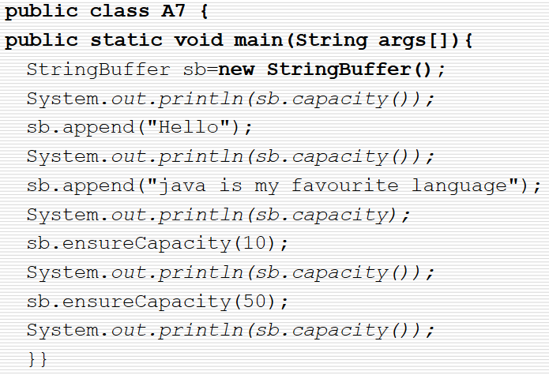
Example of ensureCapacity() method of StringBuffer class
16
(16*2)+2=34
34
(34*2)+2=70

Slide 64
Commonly used methods of StringBuffer class - 8
public char charAt(int index): is used to return the character at the specified position.
public int length(): is used to return the length of the string i.e. total number of characters.

Slide 65
Commonly used methods of StringBuffer class - 9
public String substring(int beginIndex): is used to return the substring from the specified beginIndex.
public String substring(int beginIndex, int endIndex): is used to return the substring from the specified beginIndex and endIndex

Slide 66
StringBuilder class - 1
The StringBuilder class is used to create mutable (modifiable) string
The StringBuilder class is same as StringBuffer class except that it is non-synchronized. It is available since JDK1.5

Slide 67
StringBuilder class - 2
Commonly used Constructors of StringBuilder class
  StringBuilder(): creates an empty string buffer with the initial capacity of 16.
  StringBuilder(String str): creates a string buffer with the specified string.
  StringBuilder(int length): creates an empty string buffer with the specified capacity as length

Slide 68
Commonly used methods of StringBuilder class - 1
public StringBuilder append(String s): is used to append the specified string with this string. The append() method is overloaded like append(char), append(boolean), append(int), append(float), append(double) etc.
public StringBuilder insert(int offset, String s): is used to insert the specified string with this string at the specified position. The insert() method is overloaded like insert(int, char), insert(int, boolean), insert(int, int), insert(int, float), insert(int, double) etc.

Slide 69
Example of append() method of StringBuilder class
The append() method concatenates the given argument with this string.
class B1{
public static void main(String args[]){
StringBuilder sb=new StringBuilder("Hello ");
sb.append("Java");//now original string is changed
System.out.println(sb);}
}
prints Hello Java

Slide 70
Example of insert() method of StringBuilder class
The insert() method inserts the given string with this string at the given position.
class B2{
public static void main(String args[]){
StringBuilder sb=new StringBuilder("Hello ");
sb.insert(1,"Java");//now original string is changed
System.out.println(sb);
}
}
prints HJavaello

Slide 71
Commonly used methods of StringBuilder class - 2
public StringBuilder replace(int startIndex, int endIndex, String str): is used to replace the string from specified startIndex and endIndex.

Slide 72
Example of replace() method of StringBuilder class
The replace() method replaces the given string from the specified beginIndex and endIndex.
class B3{
public static void main(String args[]){
StringBuilder sb=new StringBuilder("Hello");
sb.replace(1,3,"Java");
System.out.println(sb);
}
}
prints HJavalo

Slide 73
Commonly used methods of StringBuilder class - 3
public StringBuilder delete(int startIndex, int endIndex): is used to delete the string from specified startIndex and endIndex.
public StringBuilder reverse(): is used to reverse the string.

Slide 74
Example of delete() method of StringBuilder class
The delete() method of StringBuilder class deletes the string from the specified beginIndex to endIndex.
class B4{
public static void main(String args[]){
StringBuilder sb=new StringBuilder("Hello");
sb.delete(1,3);
System.out.println(sb);
}
}
prints Hlo

Slide 75
Example of reverse() method of StringBuilder class
The reverse() method of StringBuilder class reverses the current string.
class B5{
public static void main(String args[]){
StringBuilder sb=new StringBuilder("Hello");
sb.reverse();
System.out.println(sb);
}
}
prints olleH

Slide 76
Commonly used methods of StringBuilder class - 4
int capacity(): is used to return the current capacity.
public void ensureCapacity(int minimumCapacity): is used to ensure the capacity at least equal to the given minimum.

Slide 77
capacity() method of StringBuilder class
The capacity() method of StringBuilder class returns the current capacity of the Builder. The default capacity of the Builder is 16. If the number of character increases from its current capacity, it increases the capacity by (oldcapacity*2)+2.
Ex: if your current capacity is 16, it will be (16*2)+2=34

Slide 78
Example of capacity() method of StringBuffer class
public class B6 {
public static void main(String args[]){
StringBuilder sb=new StringBuilder();
System.out.println(sb.capacity());
sb.append("Hello");
System.out.println(sb.capacity());
sb.append("java is my favourite language");
System.out.println(sb.capacity());}
}
16
(16*2)+2=34

Slide 79
ensureCapacity() method of StringBuilder class
The ensureCapacity() method of StringBuilder class ensures that the given capacity is the minimum to the current capacity. If it is greater than the current capacity, it increases the capacity by (oldcapacity*2)+2.
Ex: if your current capacity is 16, it will be (16*2)+2=34.

Slide 80
Commonly used methods of StringBuilder class - 5
public char charAt(int index): is used to return the character at the specified position.
public int length(): is used to return the length of the string i.e. total number of characters.

Slide 81
Commonly used methods of StringBuilder class – 6
public String substring(int beginIndex): is used to return the substring from the specified beginIndex.
public String substring(int beginIndex, int endIndex): is used to return the substring from the specified beginIndex and endIndex.

Slide 82
toString() method
If you want to represent any object as a string, toString() method comes into existence.
The toString() method returns the string representation of the object. If you print any object, java compiler internally invokes the toString() method on the object.
So overriding the toString() method, returns the desired output, it can be the state of an object etc. depends on your implementation
By overriding the toString() method of the Object class, we can return values of the object, so we don't need to write much code

Slide 83
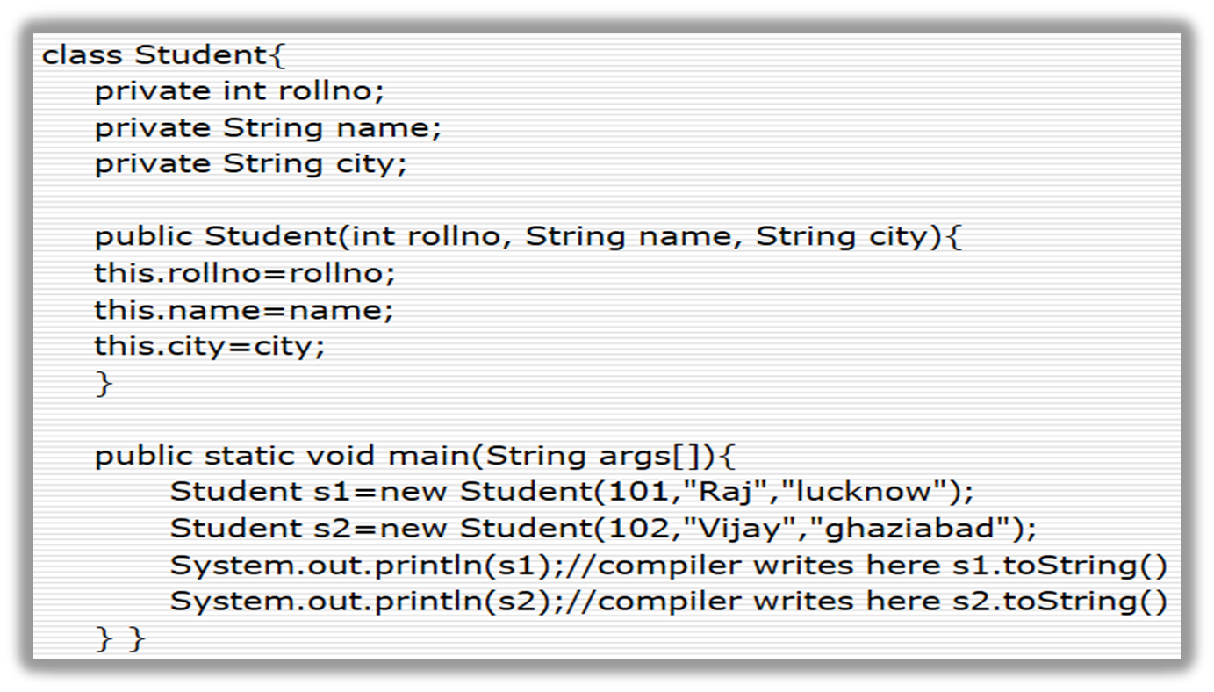
Problem without toString() method
Student@1fee6fc
Student@1fee6fc
Notes:
Output: Student@1fee6fc
c
As you can see in the above example, printing s1 and s2 prints the hashcode values of the objects but I want to print the values of these objects. Since java compiler internally calls toString() method, overriding this method will return the specified values. Let's understand it with the example given below:

Slide 84
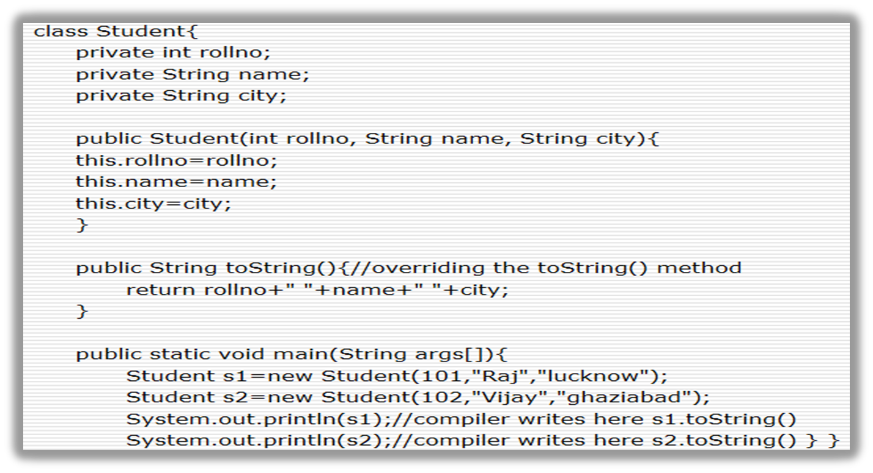
Understanding the actual use of toString() method
101 Raj lucknow
102 Vijay ghaziabad
Notes:
Output: 101 Raj lucknow
102 Vijay ghaziabad

Slide 85
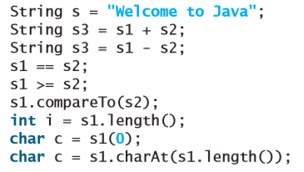
Exercise 1
Suppose that s1 and s2 are two strings. Which of the following statements or expressions are incorrect?

Slide 86
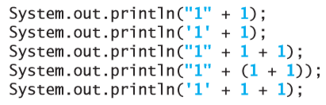
Exercise 2
Show the output of the following statements (write a program to verify your results):

Slide 87

Summary (part 1 of 5)
The character type char represents a single character.
An escape sequence consists of a backslash (\) followed by a character or a combination of digits.
The character \ is called the escape character.
The characters ' ', \t, \f, \r, and \n are known as the whitespace characters.

Slide 88
Summary (part 2 of 5)
Characters can be compared based on their Unicode using the relational operators.
The Character class contains the methods isDigit, isLetter, isLetterOrDigit, isLowerCase, isUpperCase for testing whether a character is a digit, letter, lowercase, and uppercase. It also contains the toLowerCase and toUpperCase methods for returning a lowercase or uppercase letter.

Slide 89
Summary (part 3 of 5)
A string is a sequence of characters. A string value is enclosed in matching double quotes ("). A character value is enclosed in matching single quotes (').
Strings are objects in Java. A method that can only be invoked from a specific object is called an instance method. A non-instance method is called a static method, which can be invoked without using an object

Slide 90
Summary (part 4 of 5)
You can get the length of a string by invoking its length() method, retrieve a character at the specified index in the string using the charAt(index) method, and use the indexOf and lastIndexOf methods to find a character or a substring in a string.
You can use the concat method to concatenate two strings, or the plus (+) operator to concatenate two or more strings.

Slide 91
Summary (part 5 of 5)
You can use the substring method to obtain a substring from the string.
You can use the equals and compareTo methods to compare strings. The equals method returns true if two strings are equal, and false if they are not equal. The compareTo method returns 0, a positive integer, or a negative integer, depending on whether one string is equal to, greater than, or less than the other string.

Slide 92
References (part 1 of 2)
Read
Chapter 4 from page 130 page 138
Chapter 10 from page 386 page 409
of the material:
Liang, Daniel Y. (2014). Introduction to Java Programming Comprehensive, 10th Edition. U.S: Pearson-Prentice Hall.

Slide 93
References (part 2 of 2)
Java String
  https://www.youtube.com/watch?v=sliTbMkQBZ4&list=PLS1QulWo1RIbfTjQvTdj8Y6yyq4R7g-Al&index=15

